Slide 1
Software Quality Assurance and Testing Technology
2nd Semester, Spring 2022
Haiming Liu
School of Software Engineering
Beijing Jiaotong University
Sunday, May 29, 2022

Slide 2
Software Quality
Topics in Testing Software
Software Quality

Slide 3
What is Software Quality Assurance?

Slide 4
What is Quality?
Quality – developed product meets it’s specification
Problems:
• Development organization has requirements exceeding customer's specifications (added cost of product development)
• Certain quality characteristics can not be specified in unambiguous terms (i.e. maintainability)
• Even if the product conforms to it’s specifications, users may not consider it to be a quality product (because users may not be involved in the development of the requirements)

Slide 5
What is Quality Management?
Quality Management – ensuring that required level of product quality is achieved
• Defining procedures and standards
• Applying procedures and standards to the product and process
• Checking that procedures are followed
• Collecting and analyzing various quality data
Problems:
• Intangible aspects of software quality can’t be standardized (i.e elegance and readability)

Slide 6
What are SQA, SQP, SQC, and SQM?
SQA includes all 4 elements…
Software Quality Assurance – establishment of network of organizational procedures and standards leading to high-quality software
Software Quality Planning – selection of appropriate procedures and standards from this framework and adaptation of these to specific software project
Software Quality Control – definition and enactment of processes that ensure that project quality procedures and standards are being followed by the software development team
Software Quality Metrics – collecting and analyzing quality data to predict and control quality of the software product being developed

Slide 7
Software Development Cycle
Software Development Phase
• Software requirements
• Preliminary Design
• Detailed Design
• Code
• Unit Test
• Software integration
• Software Component Test
• Software System Test
• Maintenance and Support
End product
• SRS, IRS
• SDD, PQT/FAT/SAT Plans & Proc.’s, ICD, IDD
• PDL, User Manuals
• Code, UT Plan & Proc.’s
• UT Results
• VDD
• PQT Report
• FAT & SAT Reports
• updates

Slide 8
Software Development Cycle (contd.)
Req.
Maint
PD
DD
SAT
FAT
CUT
PQT
Int
Notes:
?

Slide 9
Software Quality Assurance
Element I

Slide 10
Why are Standards Important?
• Standards provide encapsulation of best, or at least most appropriate, practice
• Standards provide a framework around which the quality assurance process may be implemented
• Standards assist in continuity of work when it’s carried out by different people throughout the software product lifecycle
Standards should not be avoided. If they are too extensive for the task at hand, then they should be tailored.

Slide 11
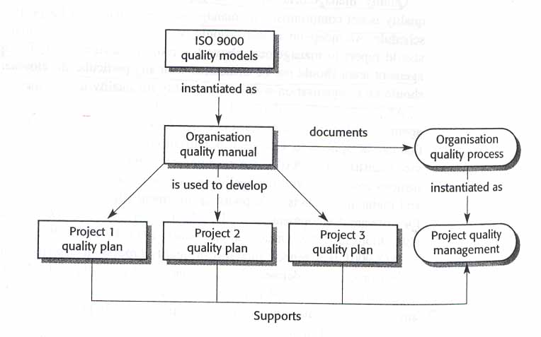
SDS a Simplistic approach
In most mature organizations:
• ISO is not the only source of SDS
• Process and Product standards are derived independently
• Product standards are not created by SQA

Slide 12
Process Standards
Process Standards – standards that define the process
which should be followed during software development
ISO
CMM
CMMI
Organizational
Quality Manual
Organizational
SD Process STD’s
IPDS
Project SQP
Project SD Process STD’s
(SDP, IP, Method Sheets)
Project SCMP

Slide 13
Product Standards
Product Standards – standards that apply to software
product being developed
ISO
STD’s
MIL/ Industry
STD’s
Organizational
Product STD’s
COTS
STD’s
Project Product STD’s (SDP, IP, Method Sheets)

Slide 14
Quality Models

Slide 15
ISO - 9000 Elements
Quality System Requirements
Management Responsibility
Quality system
Contract review
Design Control
Document control
Purchasing
Purchaser supplied product
Product identification and traceability
Process control
Inspection and testing
Inspection, measuring and test equipment
Inspection and test status
Control of non-conforming product
Corrective action
Handling, storage, preservation, packaging and shipping
Quality records
Internal quality audits
Training
Servicing
Statistical techniques
Software Quality Responsibilities
Management Responsibility
Quality system
Contract review
Design Control
Document control
Purchasing
-
Product identification and traceability
Process control
Inspection and testing
-
Inspection and test status
-
Corrective action
-
Quality records
Internal quality audits
Training
-
Statistical techniques

Slide 16
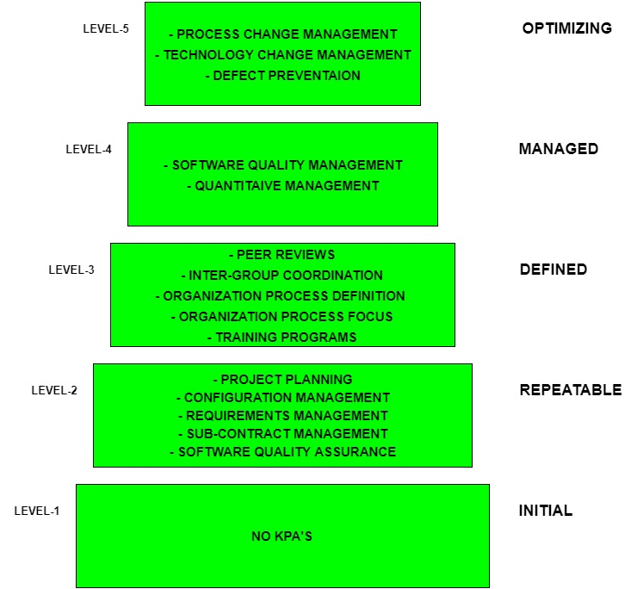
Capability Maturity Model KPA’s

Slide 17
Capability Maturity Model KPA’s
Level-1: Initial –
No KPA’s defined.
Processes followed are adhoc and immature and are not well defined.
Unstable environment for software development.
No basis for predicting product quality, time for completion, etc.

Slide 18
Capability Maturity Model KPA’s
Level-2: Repeatable –
Focuses on establishing basic project management policies.
Experience with earlier projects is used for managing new similar natured projects.
Project Planning- It includes defining resources required, goals, constraints, etc. for the project. It presents a detailed plan to be followed systematically for successful completion of a good quality software.
Configuration Management- The focus is on maintaining the performance of the software product, including all its components, for the entire lifecycle.
Requirements Management- It includes the management of customer reviews and feedback which result in some changes in the requirement set. It also consists of accommodation of those modified requirements.
Subcontract Management- It focuses on the effective management of qualified software contractors i.e. it manages the parts of the software which are developed by third parties.
Software Quality Assurance- It guarantees a good quality software product by following certain rules and quality standard guidelines while development.

Slide 19
Capability Maturity Model KPA’s
Level-3: Defined –
At this level, documentation of the standard guidelines and procedures takes place.
It is a well defined integrated set of project specific software engineering and management processes.
Peer Reviews- In this method, defects are removed by using a number of review methods like walkthroughs, inspections, buddy checks, etc.
Intergroup Coordination- It consists of planned interactions between different development teams to ensure efficient and proper fulfillment of customer needs.
Organization Process Definition- It’s key focus is on the development and maintenance of the standard development processes.
Organization Process Focus- It includes activities and practices that should be followed to improve the process capabilities of an organization.
Training Programs- It focuses on the enhancement of knowledge and skills of the team members including the developers and ensuring an increase in work efficiency.

Slide 20
Capability Maturity Model KPA’s
Level-4: Managed –
At this stage, quantitative quality goals are set for the organization for software products as well as software processes.
The measurements made help the organization to predict the product and process quality within some limits defined quantitatively.
Software Quality Management- It includes the establishment of plans and strategies to develop a quantitative analysis and understanding of the product’s quality.
Quantitative Management- It focuses on controlling the project performance in a quantitative manner.

Slide 21
Capability Maturity Model KPA’s
Level-5: Optimizing –
This is the highest level of process maturity in CMM and focuses on continuous process improvement in the organization using quantitative feedback.
Use of new tools, techniques and evaluation of software processes is done to prevent recurrence of known defects.
Process Change Management- Its focus is on the continuous improvement of organization’s software processes to improve productivity, quality and cycle time for the software product.
Technology Change Management- It consists of identification and use of new technologies to improve product quality and decrease the product development time.
Defect Prevention- It focuses on identification of causes of defects and to prevent them from recurring in future projects by improving project defined process.

Slide 22
Which ISO standard can be used in Software Quality Assurance? A ISO7000 series B ISO8000 series C ISO9990 series D ISO9000 series

Slide 23
Documentation

Slide 24
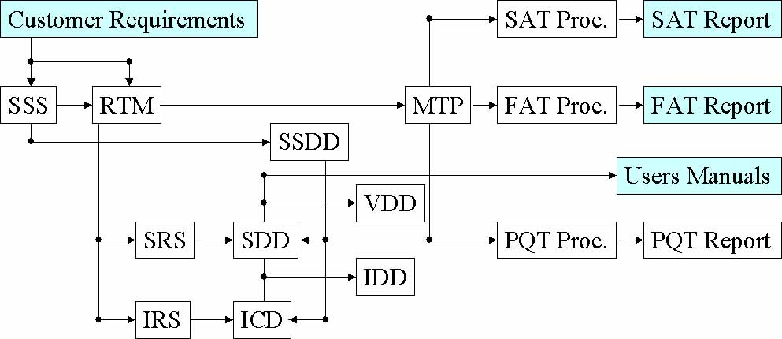
Documentation Hierarchy
• Documents are not the only tangible way of representing software products. The working software system is the most tangible way of representing software products.
• Documents are the best way to ensure software products’ understandability

Slide 25
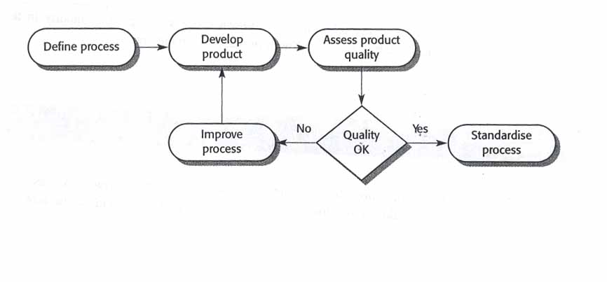
Process and Product Quality
Quality of development process directly affects the quality of
delivered products.
This is the factory approach. It doesn’t work because software is
designed rather than manufactured.

Slide 26
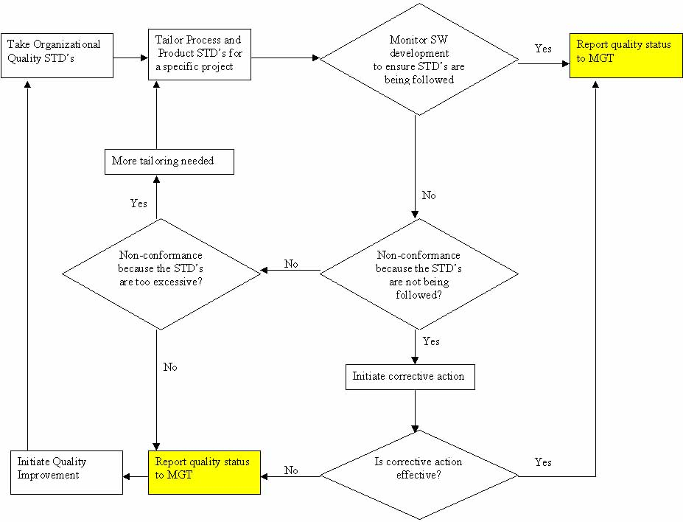
Process and Product Quality Creative Approach
• Quality Improvement – identifying good quality products,
examining the processes used to develop these products, and then
generalizing these processes so that they can be applied everywhere

Slide 27
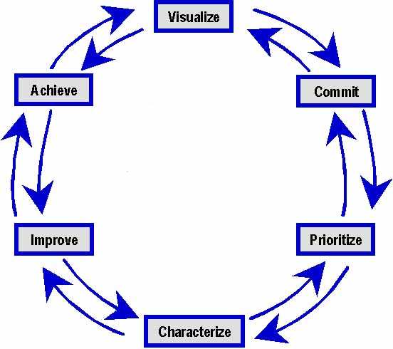
Quality Improvement – The Wheel of 6Sigma
Six Sigma

Slide 28
Quality Improvement – Six Sigma Process
• Visualize – Understand how it works now and imagine how it will work in the future
• Commit – Obtain commitment to change from the stakeholders
• Prioritize – Define priorities for incremental improvements
• Characterize – Define existing process and define the time progression for incremental improvements
• Improve – Design and implement identified improvements
• Achieve – Realize the results of the change

Slide 29
Continuity and Independence of SQA
• Software Quality Assurance team must be independent in order to take an objective view of the process and report problems to senior management directly
• If prescribed process is inappropriate for the type of software product which is being developed, then it should be tailored
• The standards must be upheld no matter how small the task. Prototyping doesn’t mean no standards. It means tailored standards.
• Quality is FREE, if it’s Everyone’s Responsibility!

Slide 30
Software Quality Planning
Element II

Slide 31
Software Quality Plan
Tailoring - SQP should select those organizational standards that are appropriate to a particular product
Standardization - SQP should use (call out) only approved organizational process and product standards
If new standards are required a quality improvement should be initiated
Elements - SQP elements are usually based on the ISO-9001 model elements
SQP is not written for software developers. It’s written for SQE’s as a guide for SQC and for the customer to monitor development activities
Things like software production, software product plans and risk management should be defined in SDP
Quality Factor shouldn’t be sacrificed to achieve efficiency. Don’t take the job if quality process can’t be upheld

Slide 32
Software Quality Control
Element III

Slide 33
Methods of Software Quality Control
SQC involves overseeing the software development process to ensure that the procedures and STD’s are being followed
The following activities constitute SQC:
• Quality Reviews - in-process reviews of processes and products
Reviews are the most widely used method of validating the quality of processes and products. Reviews make quality everyone's responsibility. Quality must be built-in. SQE is responsible for writing Quality Engineering Records (QERs) documenting their participation in these reviews.
• Tests - end-result verifications of products. These verifications are conducted after the software has been developed. Test procedures are followed during conduct of these activities. SQE is responsible for keeping the logs and some times for writing the test report.
• Quality Audits - in-process verifications of processes. These audits are conducted periodically (twice a month) to assess compliance to the process STD’s.

Slide 34
Quality Reviews
• Peer reviews
• Walkthroughs
• Inspections

Slide 35
Tests
• Engineering Dry-run - test conducted by engineering without SQE. These tests include Unit Tests and engineering dry-runs of the formal tests. These engineering dry-runs are used to verify correctness and completeness of the test procedures. Also, these is the final engineering verification of the end-product before sell-off to SQE.
• SQE Dry-run - test conducted by SQE. These tests include PQT, FAT and SAT dry-runs. These tests are used to verify the end-product before the formal test with the customer. An SQE is sometimes responsible for writing the test report. However, if a separate test group is available, then SQE is relived of this obligation.
• TFR - test conducted as “RFR - run-for-record” with the SQE and the customer. These tests include FAT and SAT. These tests are conducted to sell the end-product off to the customer. SQE is present at all such tests

Slide 36
Quality Audits
• SQE Audits - audits conducted by SQE to verify that the process STD’s are being followed. Examples of these audits are IPDS compliance, Configuration Control, and Software Engineering Management. All findings for these audits are documented on QER forms. The results of the audits are distributed to the next level of management (above project level). If the issue(s) are not fixed then the findings are elevated to upper management.
• Independent Audits - audits conducted by ISO generalists or other independent entities to verify that the process STD’s are being followed. These audits are usually conducted on a division/facility level. The results of these audits are distributed to upper management.

Slide 37
Software Configuration Management
SCM – activities assuring that software products are properly identified and their transition is tracked. In many mature organizations SCM is not part of SQA responsibilities.
• Baseline Identification – identification of initial state of the product
• Change Identification – identification of changes made to the baseline
• Change Control – documentation of changes via revision history, change summary, or using automated development tools (ClearCase or Apex)
• Status Accounting – reporting changes to others and monitoring completeness of the project archives
• Preservation – keeper of the software products

Slide 38
Software Quality Metrics
Element IV

Slide 39
Metrics Collection
• Software measurement - the process of deriving a numeric value
for some attribute of a software product or a software process. Comparison of these values to each other and to STD’s allows drawing conclusions about the quality of software products or the process.
• The focus of the metrics collecting programs is usually on collecting metrics on program defects and the V&V process.
• Metrics can be either Control Metrics or Predictor Metrics
• Most of the “Ilities” can not be measured directly unless there’s historical data. Instead, tangible software product attributes are measured and the “Ility” factors are derived using predefined relationships between measurable and synthetic attributes.
• The boundary conditions for all measurements should be established in advance and then revised once a large databank of historical data has been established

Slide 40
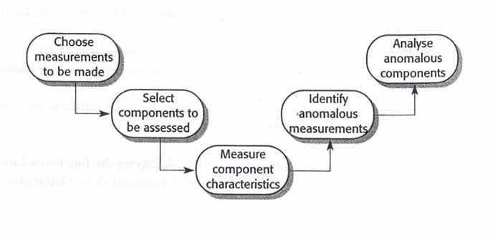
The Process of Product Measurement
1. Decide what data is to be collected
2. Assess critical (core) components first
3. Measuring component characteristics might require automated tools
4. Look for consistently (unusually only works in a factory) high or low values
5. Analysis of anomalous components should reveal if the quality of product is compromised

Slide 41
Software Product Metrics
There are two categories of software product metrics:
1. Dynamic metrics – this metrics is collected by measuring elements
during program’s execution. This metrics help to asses efficiency and
reliability of a software product. The parameters collected can be
easily measured (i.e. execution time, mean time between failures)
2. Static metrics – this metrics is collected by measuring parameters of
the end products of the software development. This metrics help to
asses the complexity, understandability, and maintainability of a
software product. The SLOC size and ND are the most reliable
predictors of understandability, complexity, and maintainability.

Slide 42
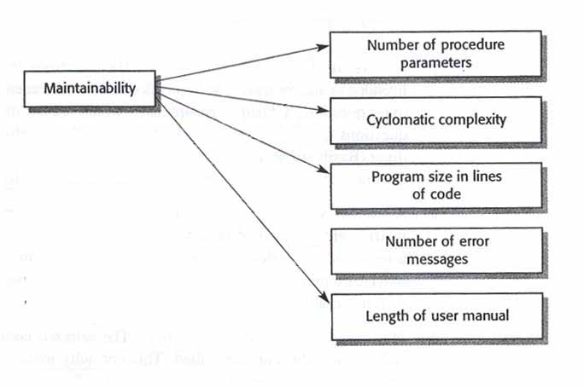
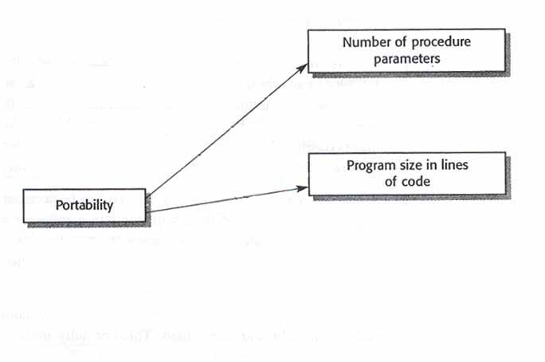
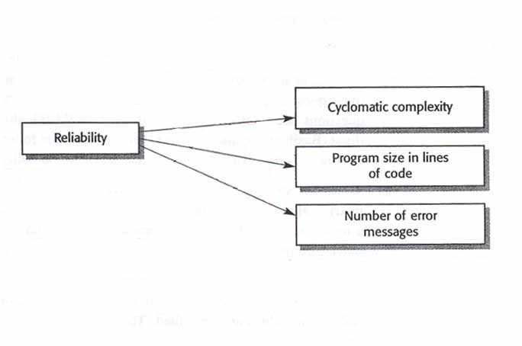
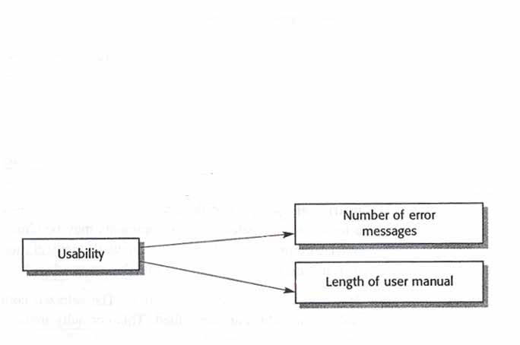
The Ilities
The specific metrics that are relevant depend on the on the project, the goals of the SQA, and the type of SW that is being developed.

Slide 43
Defect Prevention
Defect Prevention – establishment of practices that lower the reliance on defect detection techniques to find majority of the bugs
• Lessons learned – learning from other peoples experiences and sharing own experiences with the other projects
• Managing With Metrics – collecting the metrics, understanding it, and making changes to the product or process based on analysis. Metrics must be standardized to be effective.
• Risk Analysis – identifying potential risks and opportunities early in the program and tracking them to realization.
• Build freeze – no changes are made to the code during formal tests.
• Unit-level testing guidelines – test plans and procedures for each UT
• Baseline acceptance criteria – establishment of closure criteria in advance

Slide 44
To be continued… See you next week

